Slide 1

CampusTrack – Intelligent Lost and Found Locator
Infosys Virtual Internship 6.0 Java Full Stack
Mentor :
Suramya Biswas
Team Members:
Jeevitha Sakthivel K S Surendar K
Snehal Singh
Raju Varla

Slide 2

AGENDA
INľRODUCľION
PROBĮEM Sľ6ľEMENľ ľECHNOĮOGY Sľ6CK KEY OUľCOMES PROJECľ OUľCOMES OUR 6PPĮIC6ľION
IUľURE ENH6NCEMENľ & CH6ĮĮENGES
CONCĮUSION

Slide 3

Introduction
CampusTrack is an intelligent lost & found web application
Losing personal belongings on campus is a frequent issue.
Helps students and staff report lost and found items
Traditional notice boards are inefficient. CampusTrack provides a centralized digital solution.

Slide 4

Problem Statement
Chaotic paper notices
Lost items are reported manually Scattered Information
Delays in item recovery

Slide 5









Technology Stack
Backend:
Programming language & framework
Frontend:
3.5.7
Build tool and API handling
Database:
Authentication & Authorization

Slide 6




Technology Stack
IDE:
Version Control
Dependencies
Spring-boot-starter-web : Spring-boot-starter-data-jpa : Spring-boot-starter-security : Mysql-connector-j :
Spring-boot-starter-websocket :
REST APIs
Database ORM
Authentication & security MySQL connection
Real-time chat
Commons-text (Apache Commons Text) : Input sanitization
Spring-boot-starter-test: Testing

Slide 7

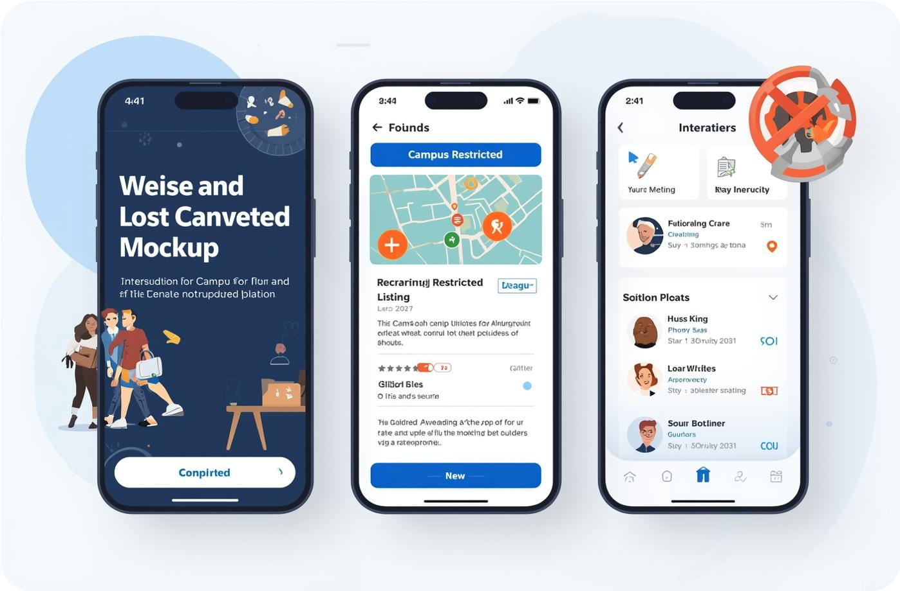

Key Outcomes of the Campusľrack
Lost & Found Item Reporting
Users submit comprehensive
descriptions with location details, and timestamps to create detailed item records.
Intelligent Search & Match(Fuzzy Logic)
Intelligent matching connects lost items with found items using item details and location.
Real-Time Communication Module
Users able to communicate to other users to share about the lost and found item details

Slide 8


Authentication and Role Management
Secure login system
Role-based access (Student / Admin)
Data privacy and secure authentication
Admin has moderation privileges

Slide 9


Fuzzy Matching
Fuzzy logic allows approximate matching
Laptop
Instead of YES / NO, it gives a similarity score
Compares: Item Name Category Color Brand
Returns best matching found items
Lap
HP
Laptopp
Dell Lapetop
Įightweight JavaScript fuzzy search library-Fuse.js Įibrary

Slide 10

Chat Messaging
Enables instant communication between users.
Supports direct messaging related to lost and found items.
Allows users to ask questions, clarify item details, and coordinate pick-up.

Slide 11
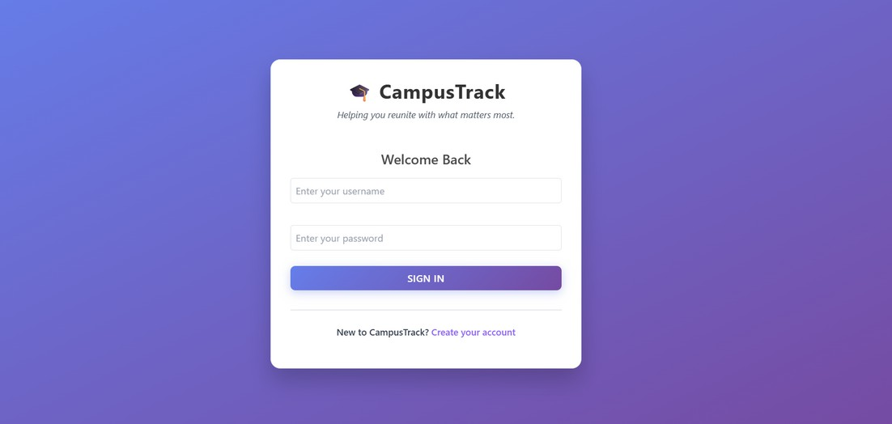
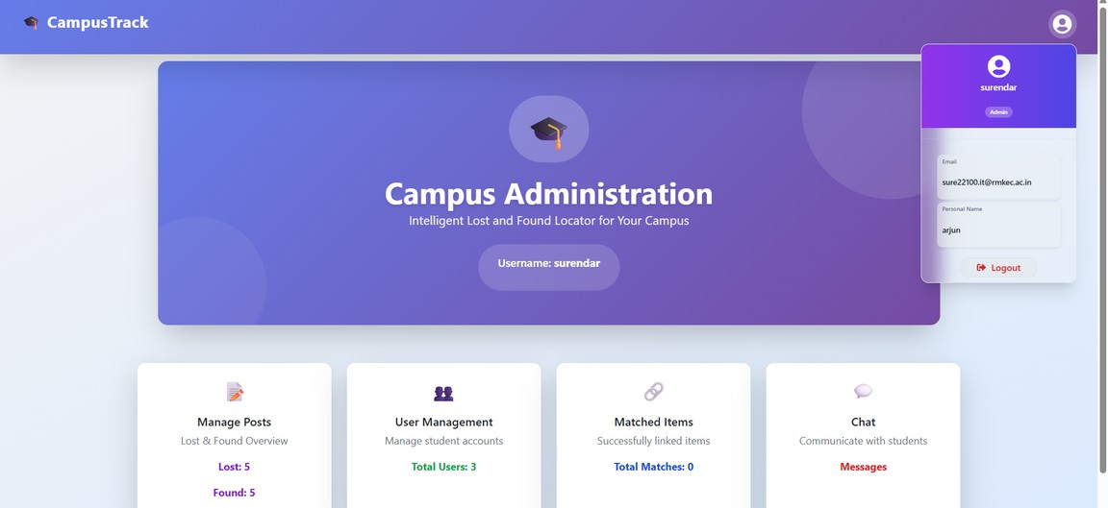
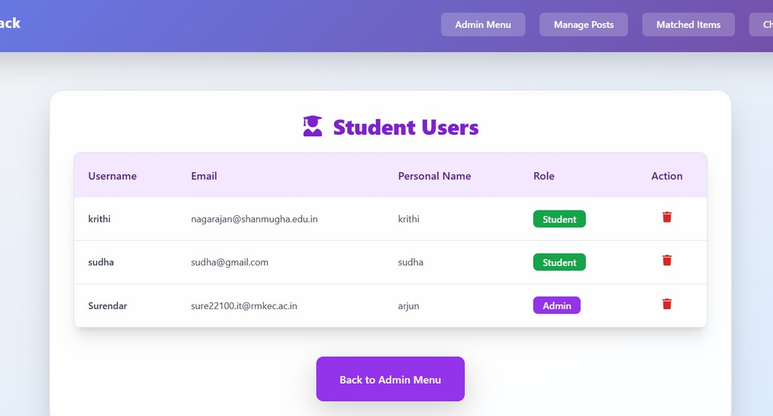
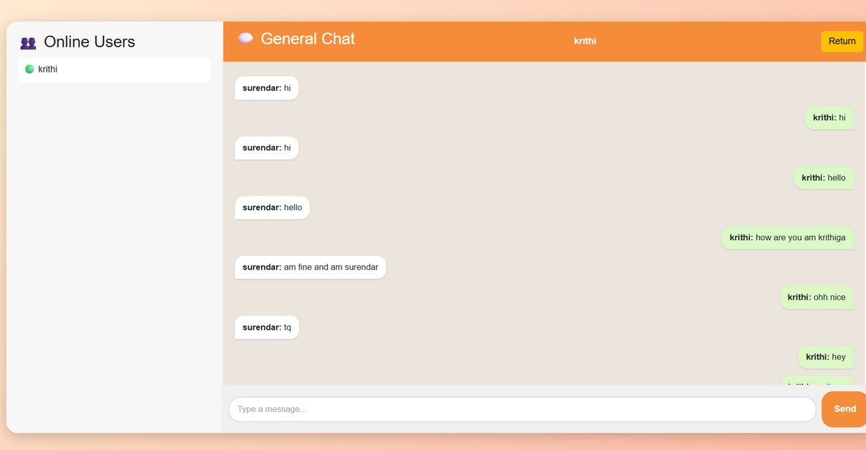
Our Application

Slide 12
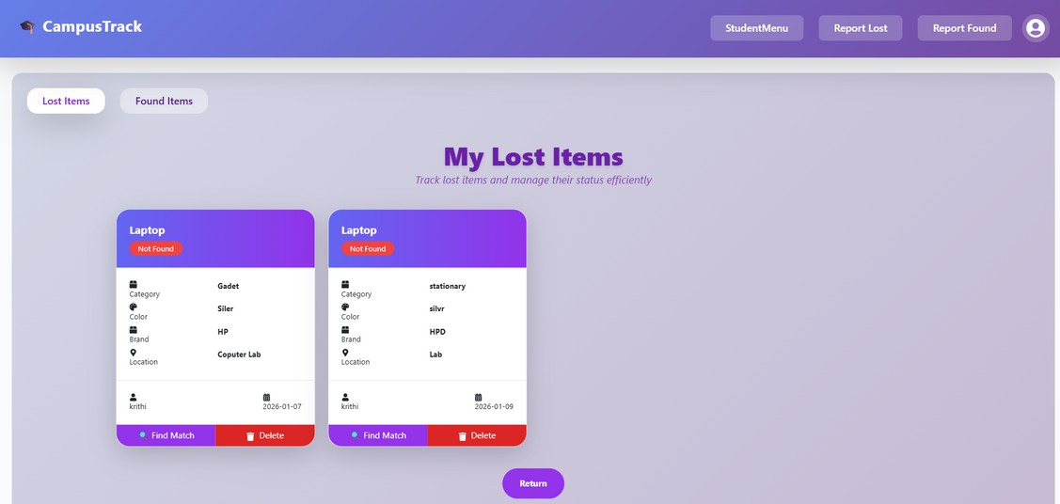
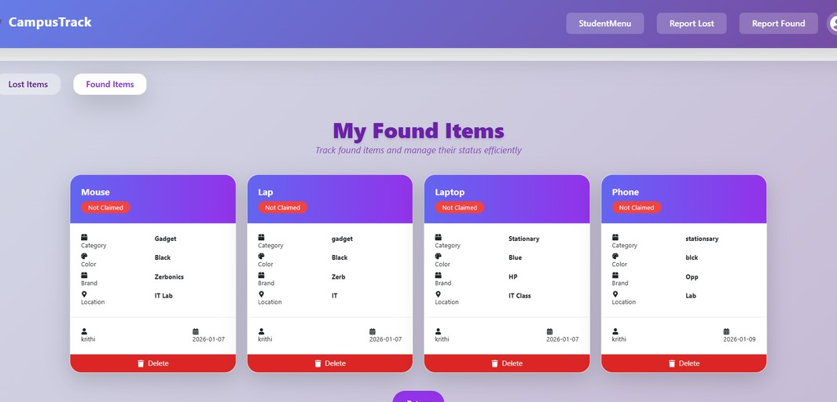
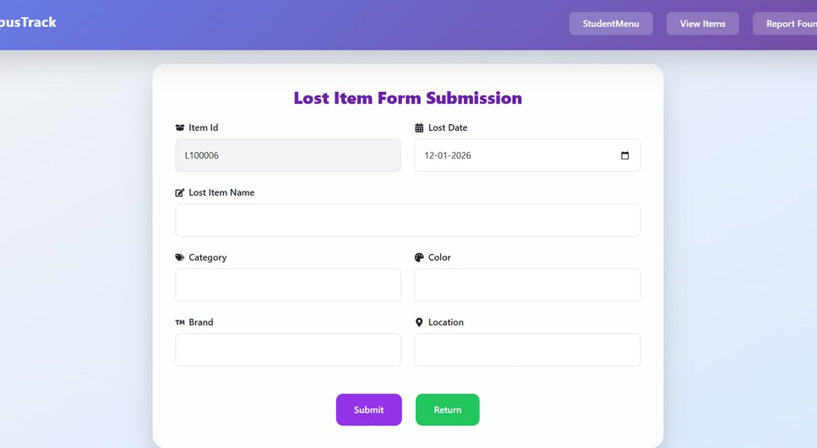
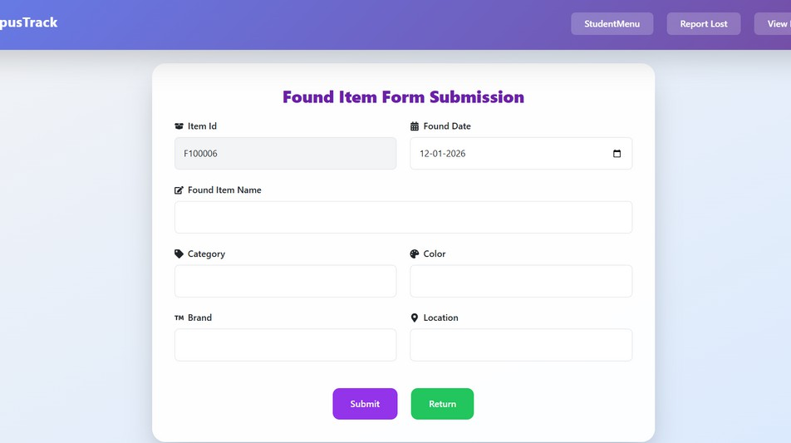
Our Application

Slide 13

Future Enhancements
Mobile application integration
Real-time notifications and alerts Įocation tracking using GPS
Challenges
Ensuring data privacy and security Preventing fake or misleading posts Handling large number of users

Slide 14

Conclusion
Efficient campus lost & found system
Saves time and effort Improves item recovery rate Easy to use and scalable

Slide 15
Thank You...

